Slide 1
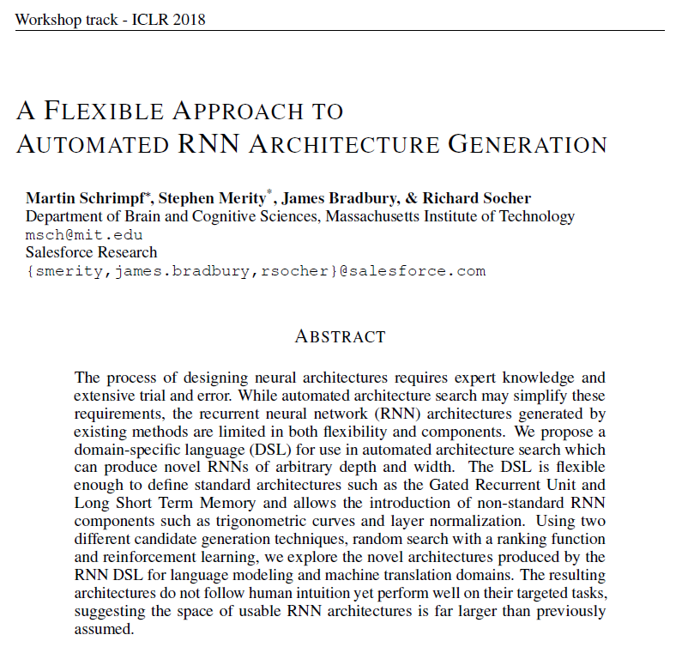

Slide 2
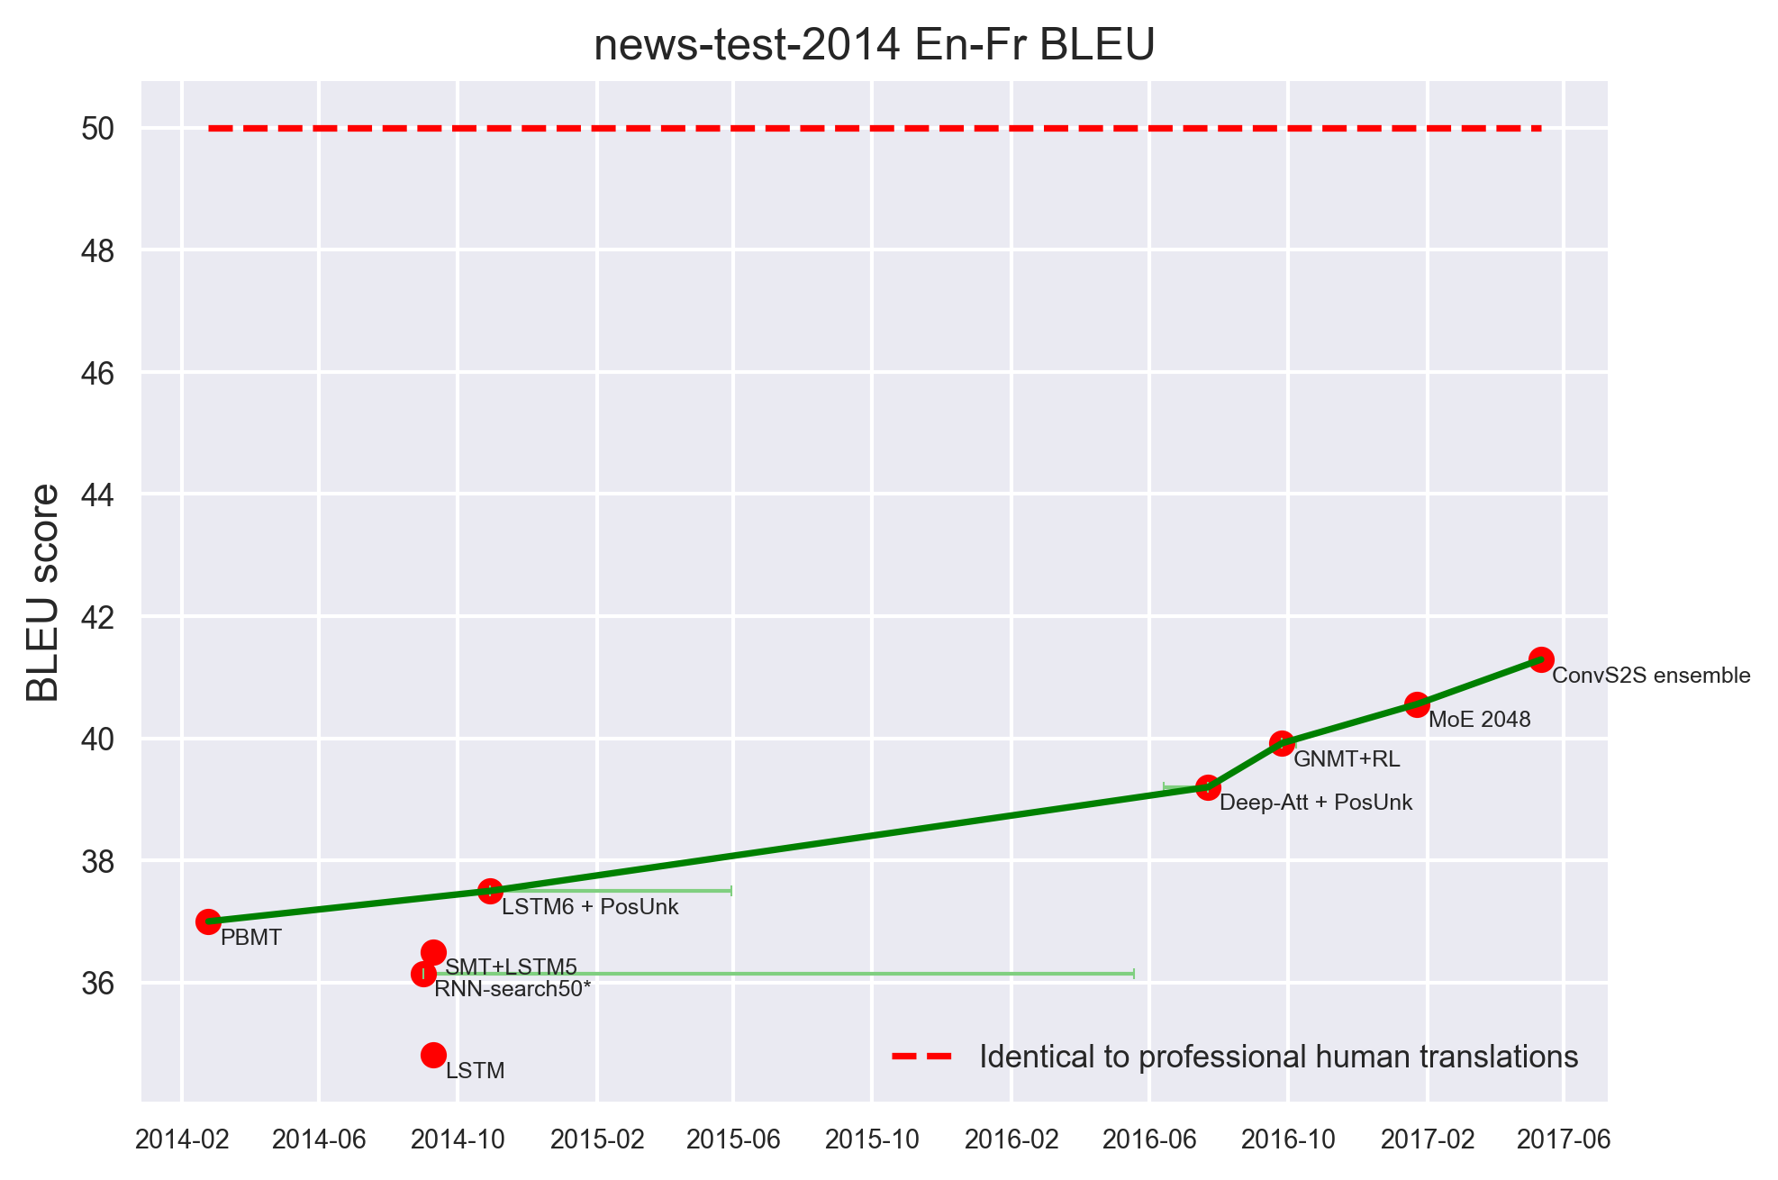
Designing architectures by hand is hard
Change architecture
Run experiments on architecture
Analyze results (and bugs, training details, …)
McCulloch-Pitts Neuron: 1943
LSTM: 1997
Notes:
Huge search space
Expensive human labour

Slide 3
Search architectures automatically
Controller
Change architecture
Run experiments on architecture
Analyze results (and bugs, training details, …)
speed up architecture search enormously
remove the human prior
perhaps reveal what makes a good architecture
Performance Reward
Boot up GPUs
Baker et al. 2016, Zoph and Le 2017

Slide 4
Recurrent Neural Networks (RNN)
$$h_{t}$$
RNN
$$x_{t}$$

Slide 5
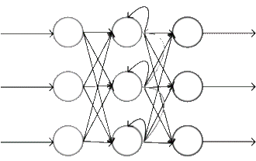
Recurrent Neural Networks (RNN)
$$h_{t}$$
$$h_{t−1}$$
$${ c}_{t}$$
$$x_{t−1}$$
$$x_{t}$$
Commonly used: Long Short-Term Memory (LSTM)

Slide 6
Outline
Flexible language (DSL) to define architectures
Components: Ranking Function & Reinforcement Learning Generator
Experiments: Language Modeling & Machine Translation

Slide 7
Domain Specific Language (DSL) or how to define an architecture
Zoph and Le 2017
Notes:
Zoph et al.: Limited, grow bottom-up

Slide 8
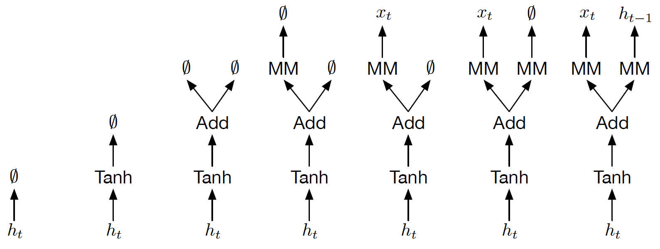
Domain Specific Language (DSL) or how to define an architecture
$$Tanh(Add(MM\left(x_{t}\right), MM\left(h_{t−1}\right))$$

Slide 9
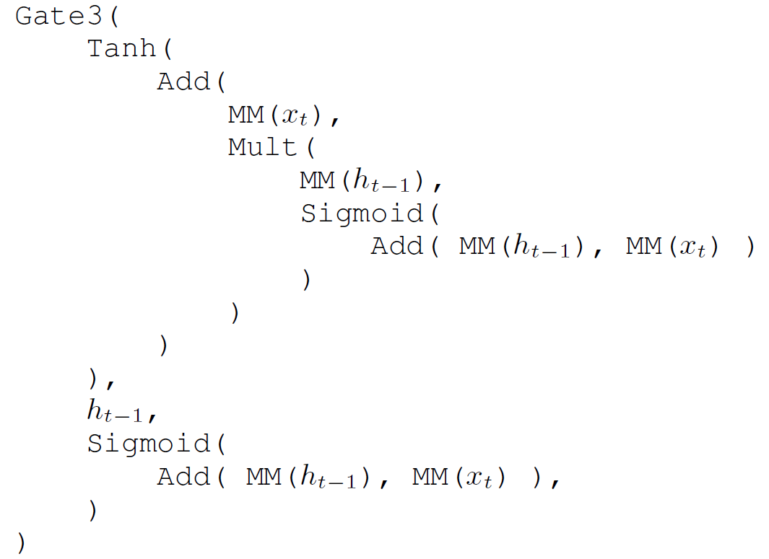
Domain Specific Language (DSL) or how to define an architecture
Notes:
Diagram from https://www.cc.gatech.edu/~san37/img/dl/gated_rnns.png

Slide 10
Domain Specific Language (DSL) or how to define an architecture
Core
Variables $x_{t},x_{t−1}, h_{t−1}$
MM
Sigmoid, Tanh, ReLU
Add, Mult
$Gate3\left(x, y, f\right)$ $=σ(f)∙x+(1−σ\left(f)\right)∙y$
Memory cell $c_{t}$
Expanded
Sub, Div
Sin, Cos, PosEnc
LayerNorm
SeLU
Notes:
Inverse of current operators
Trigonometric curves (PosEnc gives network sense of position in text)
Optimizations
New activation functions

Slide 11
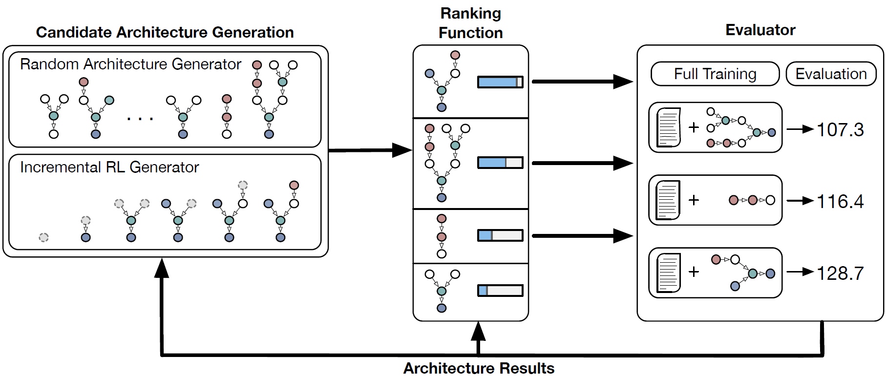
Instantiable Framework
Notes:
Framework with various instantiations
We are looking for cells → actual model will stack 2 of these cells, just like 2 LSTMs are often stacked

Slide 12
Architecture Generator
given the current architecture,
output the next operator
Random
REINFORCE
Notes:
When random: just sample any operator uniformly

Slide 13
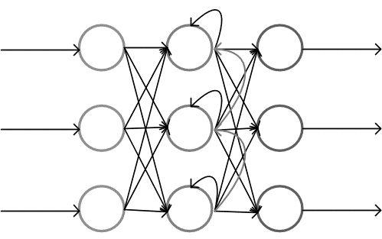
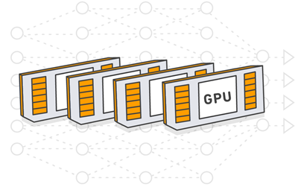
Reinforcement Learning Generator
ReLU
action
Agent
Environment
observation, reward
Performance: 42
Notes:
First create full architecture, no reward
When architecture finished, run model and yield reward
TreeLSTM-ish: recursively apply LSTM to operator, share weights between same operator
Trimmed to learn local knowledge about which operator works best next
RNN image from https://www.codeproject.com/KB/AI/1206388/rnn_5.PNG
GPU image from AWS

Slide 14
Ranking Function
Goal: predict performance of an architecture
Train with architecture-performance pairs
Notes:
Goal is not to find next best operator, but to evaluate whole architecture
Can inject human knowledge (hard for off-policy learning)
Recursive Neural Network applied to architecture
Source nodes $x_{t},x_{t−1}, h_{t−1}, c_{t−1}$ represented by learned vectors
TreeLSTM (Child-Sum) for the operators in the tree

Slide 15
Ranking Function
Goal: predict performance of an architecture
Train with architecture-performance pairs
Recursive Neural Network applied to architecture
Unroll the graph for $h_{t−1}, c_{t−1}$
Notes:
Goal is not to find next best operator, but to evaluate whole architecture
Can inject human knowledge (hard for off-policy learning)
Recursive Neural Network applied to architecture
Source nodes $x_{t},x_{t−1}, h_{t−1}, c_{t−1}$ represented by learned vectors
TreeLSTM (Child-Sum) for the operators in the tree

Slide 16
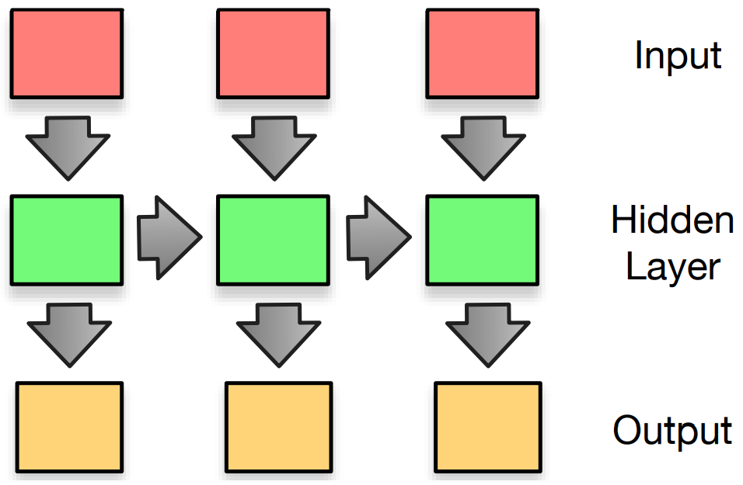
Language Modeling
$$P\left(w_{i} \right|{ w}_{1},w_{2},…,w_{i−1})$$
“Why did the chicken cross the ___”
Performance measurement: perplexity
Notes:
Feed in one word at a time
Output layer outputs probabilities for next word
Perplexity = exp(loss)
Image from http://mt-class.org/jhu/slides/lecture-nn-lm.pdf

Slide 17
Language Modeling (LM) with Random Search + Ranking Function
Notes:
Use only core DSL
Generate 50000 candidate architectures
Select 32 architectures: 28 based on ranking function, 4 weighted sampling

Slide 18
LM with Ranking Function: selected architectures improve
Notes:
WikiText: >100 million tokens extracted from verified Good and Featured articles on Wikipedia

Slide 19
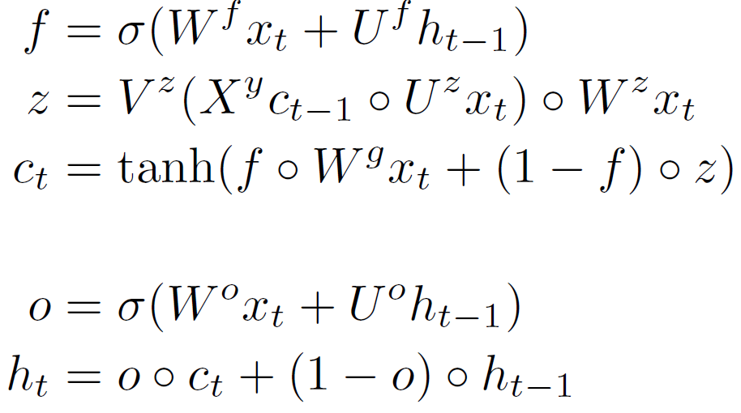
The BC3 cell
Weight matrices $W, U, V, X∈ ℝ^{H×H}$
Notes:
Complex c_t
Output not masked, mix directly between h_t-1 and c_t
Equations 1 to 3 produce the first Gate3 while equations 4 and 5 produce the second Gate3 . The
output of the first Gate3 becomes the value for ct after passing through a tanh activation.
While only the core DSL was used, BC3 still breaks with many human intuitions regarding RNN
architectures. While the formulation of the gates f and o are standard in many RNN architectures, the
rest of the architecture is less intuitive. The Gate3 that produces ct (equation 3) is mixing between a
matrix multiplication of the current input xt and a complex interaction between ct􀀀1 and xt (equation
2). In BC3, ct􀀀1 passes through multiple matrix multiplications, a gate, and a tanh activation before
becoming ct. This is non-conventional as most RNN architectures allow ct􀀀1 to become ct directly,
usually through a gating operation. The architecture also does not feature a masking output gate like
the LSTM, with outputs more similar to that of the GRU that does poorly on language modeling.

Slide 20
LM with Ranking Function: Improvement over many human architectures

Slide 21
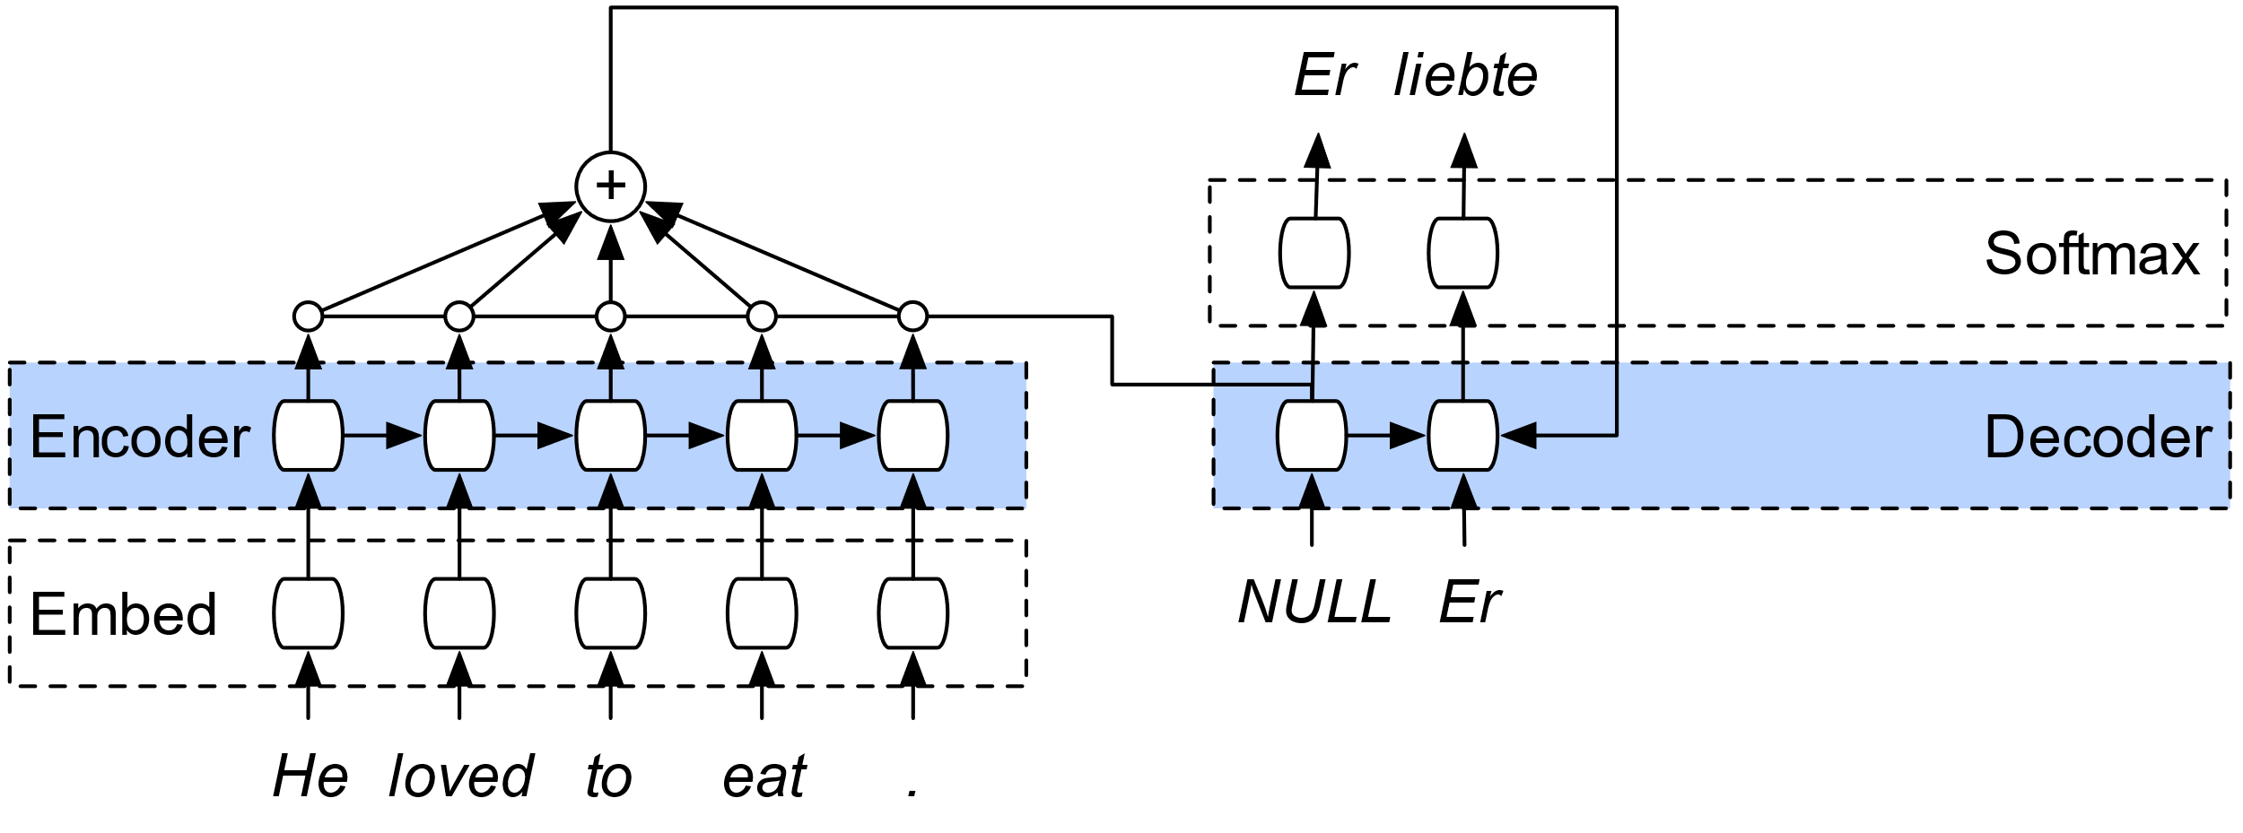
Machine Translation
Test evaluation: BLEU score
Notes:
Very similar to LM, but output different language
Attentional unidirectional encoder-decoder architecture
Image from https://smerity.com/articles/2016/google_nmt_arch.html

Slide 22
Machine Translation with Reinforcement Learning Generator

Slide 23
Machine Translation (MT) with Reinforcement Learning Generator (RL)
Generator = 3-layer NN (linear-LSTM-linear) outputting action scores
Choose action with multinomial and epsilon-greedy strategy ($ε=0.05)$
Train generator on soft priors first (use activations, …)
Small dataset to evaluate an architecture in ~2 hours
Notes:
Use full DSL

Slide 24
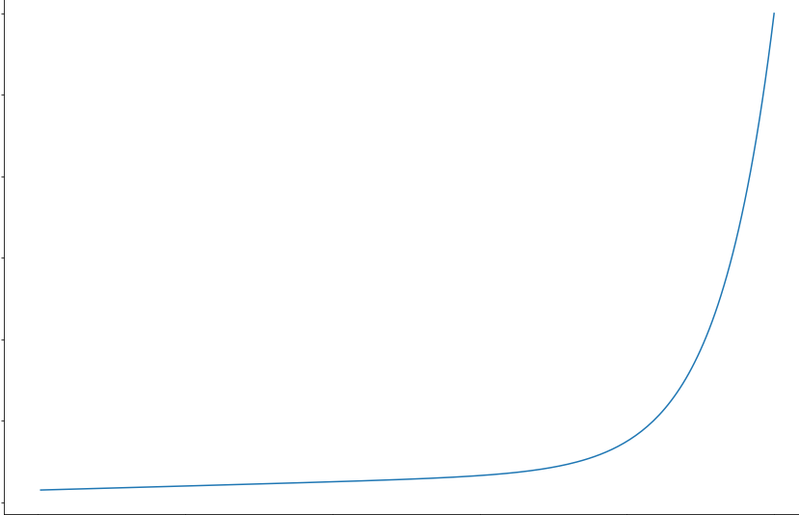
MT with RL: re-scale loss to reward great architectures more
0 Reward
∞ Loss 0
Notes:
This helped us to shift the generator more towards great architectures
No hyper-parameter search

Slide 25
MT with RL: switch between exploration and exploitation
log(performance)
Epochs
Notes:
Orange: exponential running average
Blue: individual architectures

Slide 26
MT with RL: good architectures found
Notes:
Outperform LSTM on multi30k
BUT limited generalization to larger dataset IWSLT
Transfer of loss to BLEU score far from optimal

Slide 27
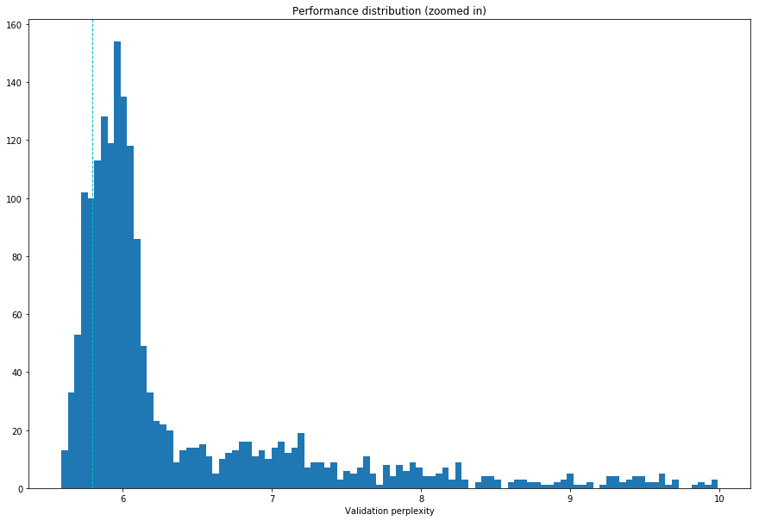
MT with RL: many good architectures found
Number of architectures
Perplexity
Notes:
806 architectures that out-performed the LSTM based on test BLEU score, out of a total of 3450 evaluated architectures (23%)

Slide 28
MT with RL: rediscovery of human architectures
$Add(Transformation\left(x_{t}\right), x_{t})$ variant of residual networks (He et al., 2016)
$Gate3\left(Transformation\left(x_{t}\right), x_{t}, Sigmoid\left(…\right)\right)$ highway networks (Srivastava et al., 2015)
Motifs found in multiple cells
Notes:
Outperform LSTM on multi30k
BUT limited generalization to larger dataset IWSLT

Slide 29
MT with RL: novel operators only used after “it clicked”
Epochs

Slide 30
MT with RL: novel operators contribute to successful architectures
Notes:
space of successful RNN architectures might hold many unexplored combinations with human bias possibly preventing their discovery

Slide 31
Related work
Hyper-parameter search: Bergstra et al. 2011, Snoek et al. 2012
Neuroevolution: Stanley et al. 2009, Bayer et al. 2009, Fernando et al. 2016, Liu et al. 2017 (← also random search)
RL search: Baker et al. 2016, Zoph and Le 2017
Subgraph selection: Pham, Guan et al. 2018
Weight prediction: Ha et al. 2016, Brock et al. 2018
Optimizer search: Bello et al. 2017
Notes:
Image from https://zdnet1.cbsistatic.com/hub/i/r/2018/01/16/56fb8896-b3b3-48ff-b3ac-51695dad6eee/resize/770xauto/8ee17ac9124ed84c101b75e30606c99b/cloud-automl-model-vision-flow.png

Slide 32
Discussion
Remove need for expert knowledge to a degree
Cost of running these experiments
us: 5 days on 28 GPUs (best architecture after 40 hours)
Zoph and Le 2017: 4 days using 450 GPUs
Hard to analyze the diversity of architectures (much more quantitative than qualitative)
Definition of search space difficult
We’re using a highly complex system to find other highly complex systems in a highly complex space

Slide 33
Contributions
Future Work
Flexible language (DSL) to define architectures
Ranking Function (Language Modeling) Reinforcement Learning Generator (Machine Translation)
Explore uncommon operators
Search architectures that correspond to biology
Allow for more flexible search space
Find architectures that do well on multiple tasks

Slide 34
Backup

Slide 35
Compilation: DSL → Model
DSL is basically executable
Traverse tree from source nodes towards final node $h_{t}$
Produce code: initialization and forward call
Collect all matrix multiplications on single source node and batch them
Notes:
To improve the running speed of the RNN cell architectures, we can collect all matrix multiplications performed
on a single source node (xt, xt􀀀1, ht􀀀1, or ct􀀀1) and batch them into a single matrix multiplication. As an
example, this optimization would simplify the LSTM’s 8 small matrix multiplications (4 for xt, 4 for ht􀀀1) into
2 large matrix multiplications. This allows for higher GPU utilization and lower CUDA kernel launch overhead.

Slide 36
RL Generator
Maximize expected reward
REINFORCE
Zoph and Le 2017

Slide 37
Restrictions on generated architectures
Gate3(…, …, Sigmoid(…))
Have to use $x_{t}, h_{t−1}$
Maximum 21 nodes, depth 8
Prevent stacking two identical operations
MM(MM(x)) is mathematically identical to MM(x)
Sigmoid(Sigmoid(x)) is unlikely to be useful
ReLU(ReLU(x)) is redundant

Slide 38
How to define proper search space?
Too small → will find nothing radically novel
Too big → need Google computing ressources
Baseline experiment parameters restrict successful architectures
Notes:
e.g. BC3 would not work with LSTM hyperparameters such as Variational Dropout

Slide 39
MT with RL: Learned encoding very different

Slide 40
MT with RL: Parent-Child operator preference

